Slide 1
Connecting OneDrive for Business

Slide 2
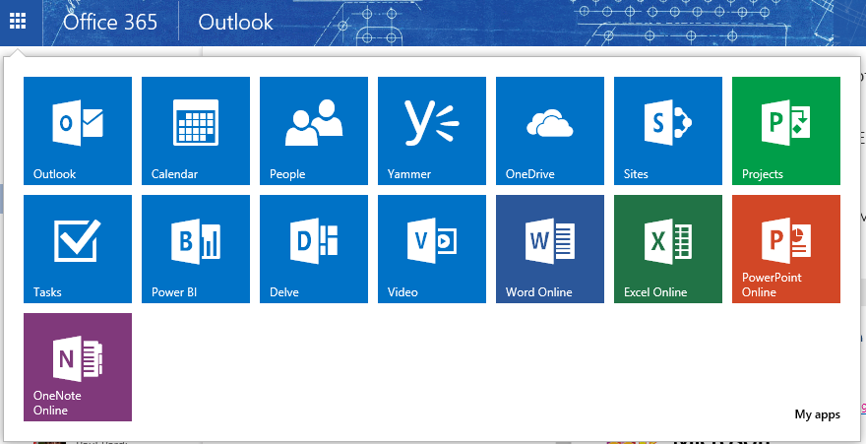
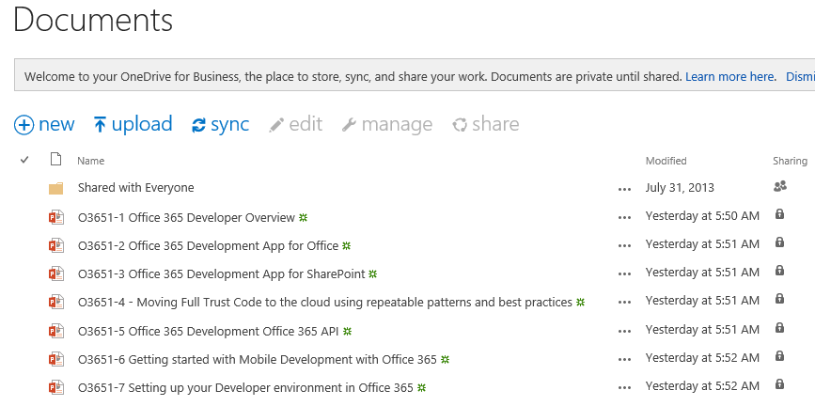
OneDrive for Business
A personal library for
storing and organizing
your work documents
Notes:
OneDrive for Business is a personal library intended for storing and organizing your work documents. As an integral part of Office 365 or SharePoint Server 2013, OneDrive for Business lets you work within the context of your organization, with features such as direct access to your organization’s address book.
Note OneDrive for Business is different from OneDrive, which is intended for personal storage separate from your workplace. OneDrive for Business is also different from your team site, which is intended for storing team or project-related documents.

Slide 3
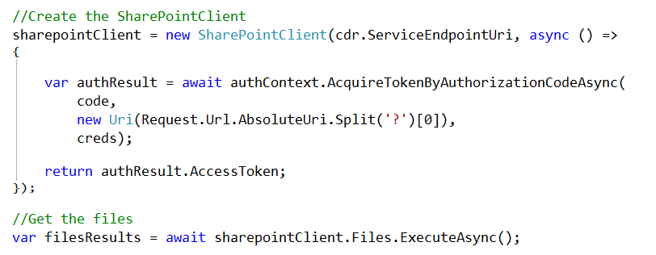
SharePointClient class
Discovery Service discovers “MyFiles” capability
Returns tenant and user-specific URL for user’s OneDrive for Business
SharePointClient.Files abstracts Files API
Notes:
The discovery service discovers the “MyFiles” capability, which will always try to access the OneDrive for Business library

Slide 4
Demo

